Slide 1
Welcome !!
Don’t forget a name tag!
Grab a 🍻

Slide 2
Wifi information 💻
SSID: HWP-Guest
PASS: hardwarepark

Slide 3
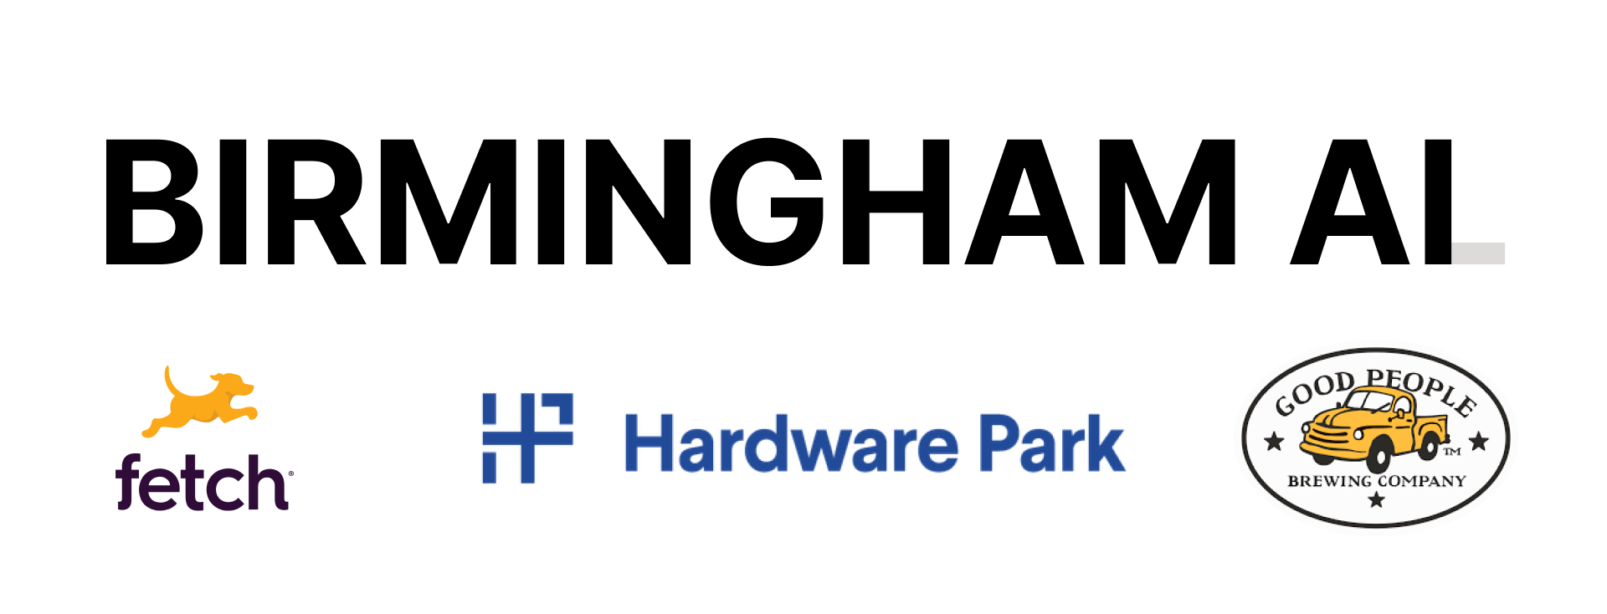
A word from our sponsors ❤️

Slide 4
tl;dr | What is this group?

Slide 5
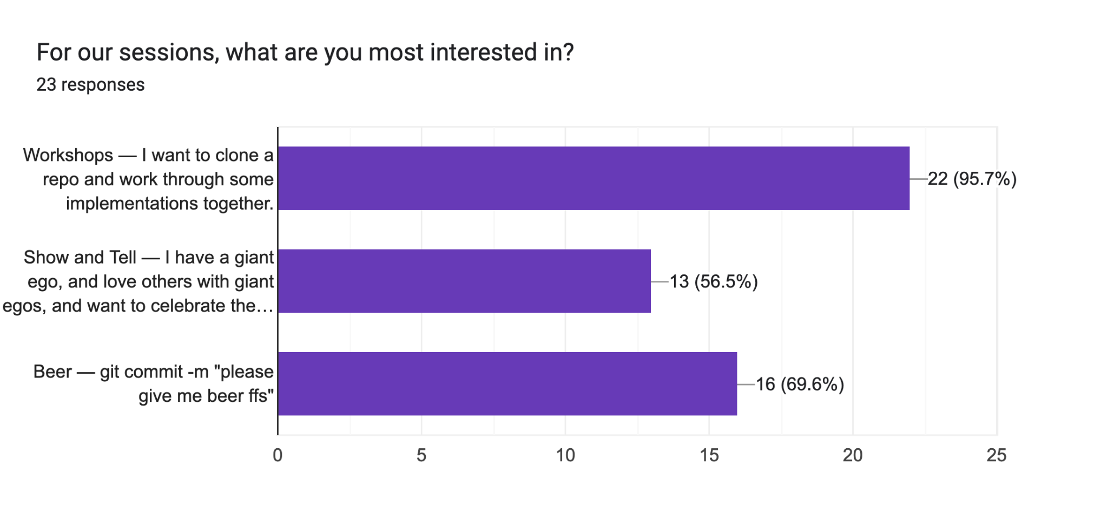
tl;dr | Why are we meeting?

Slide 6
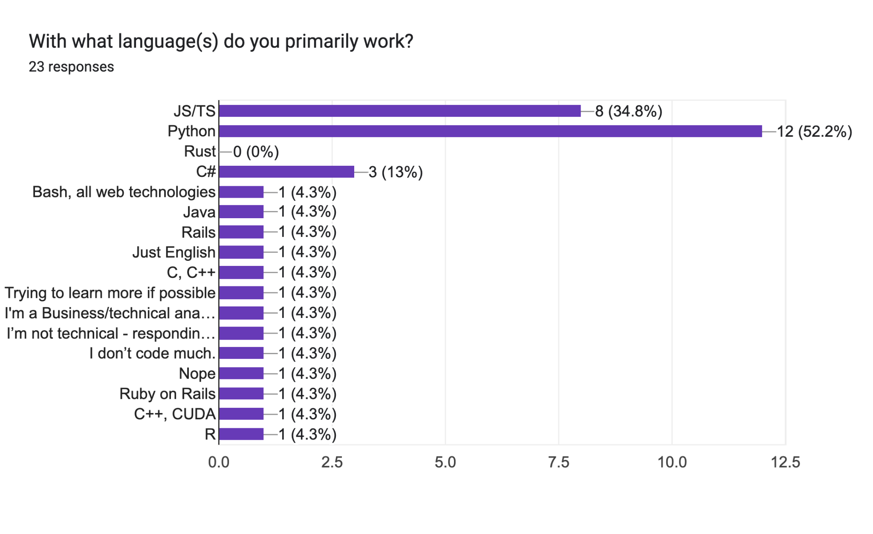
tl;dr | Why are we meeting?

Slide 7
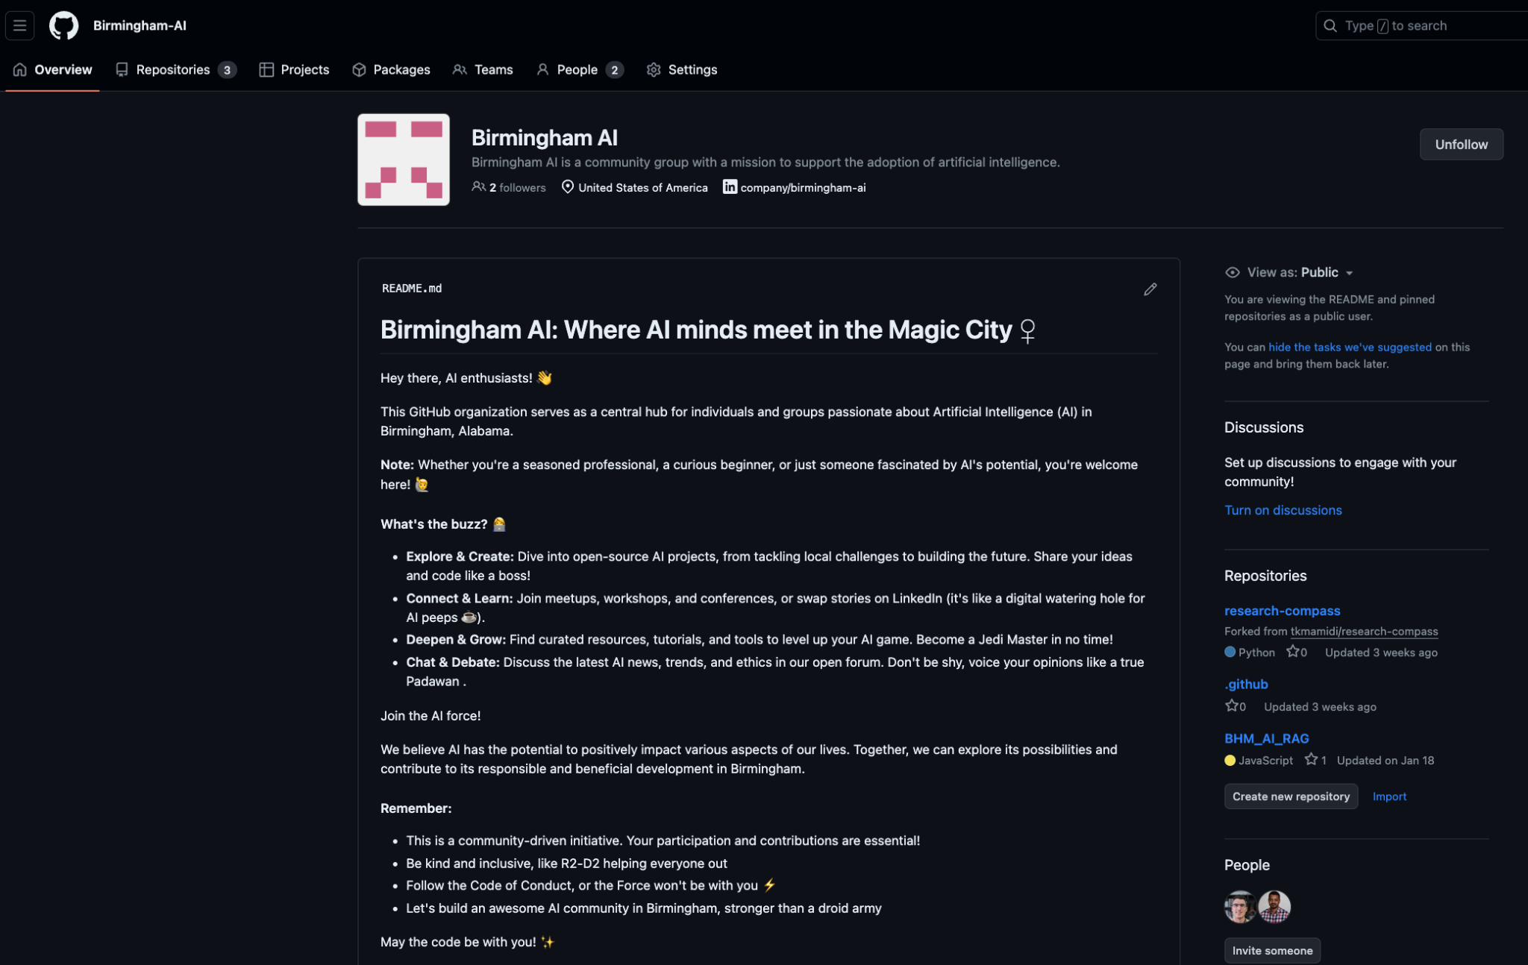

Slide 8
Developing AI apps with open-source no-code tools
(Empowering Innovation without writing code)
Yashwanth Mamidi
Senior Data Analyst
Pfizer

Slide 9
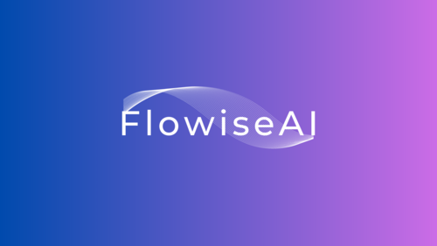
Agenda
Introduction to No-Code development
Why Flowise?
Benefits of Using No-Code Tools
Getting Started with Flowise
Q&A

Slide 10
Introduction to No-Code Development
What is No-Code Development?
Building applications without traditional programming.
Utilizes visual interfaces and pre-built components.
Why No-Code?
Faster development cycles.
Accessibility for non-developers.
Reduces dependency on technical resources

Slide 11
Why Flowise?
A no-code & open-source platform for developing AI applications
Visual Workflow Builder:
Drag-and-drop interface for creating workflows
Pre-Built Integrations:
Integrates with popular frameworks (e.g. LangChain) and vector stores (e.g. Chroma DB)
Customizable Templates:
Ready-to-use templates for AI agentic workflows

Slide 12
Benefits of Using No-Code Tools
Speed and Efficiency:
Rapid prototyping and deployment.
Cost-Effective:
Reduces the need for extensive development resources.
Empowers Non-Developers:
Enables business users to create solutions without coding skills.
Flexibility and Adaptability:
Easy to modify and iterate on workflows.

Slide 13
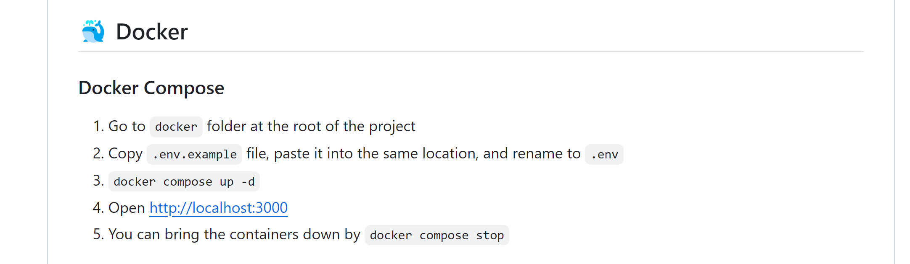
How to use Flowise?
Clone the Flowise repo (https://github.com/FlowiseAI/Flowise.git)
Compose with Docker
https://github.com/FlowiseAI/Flowise

Slide 14
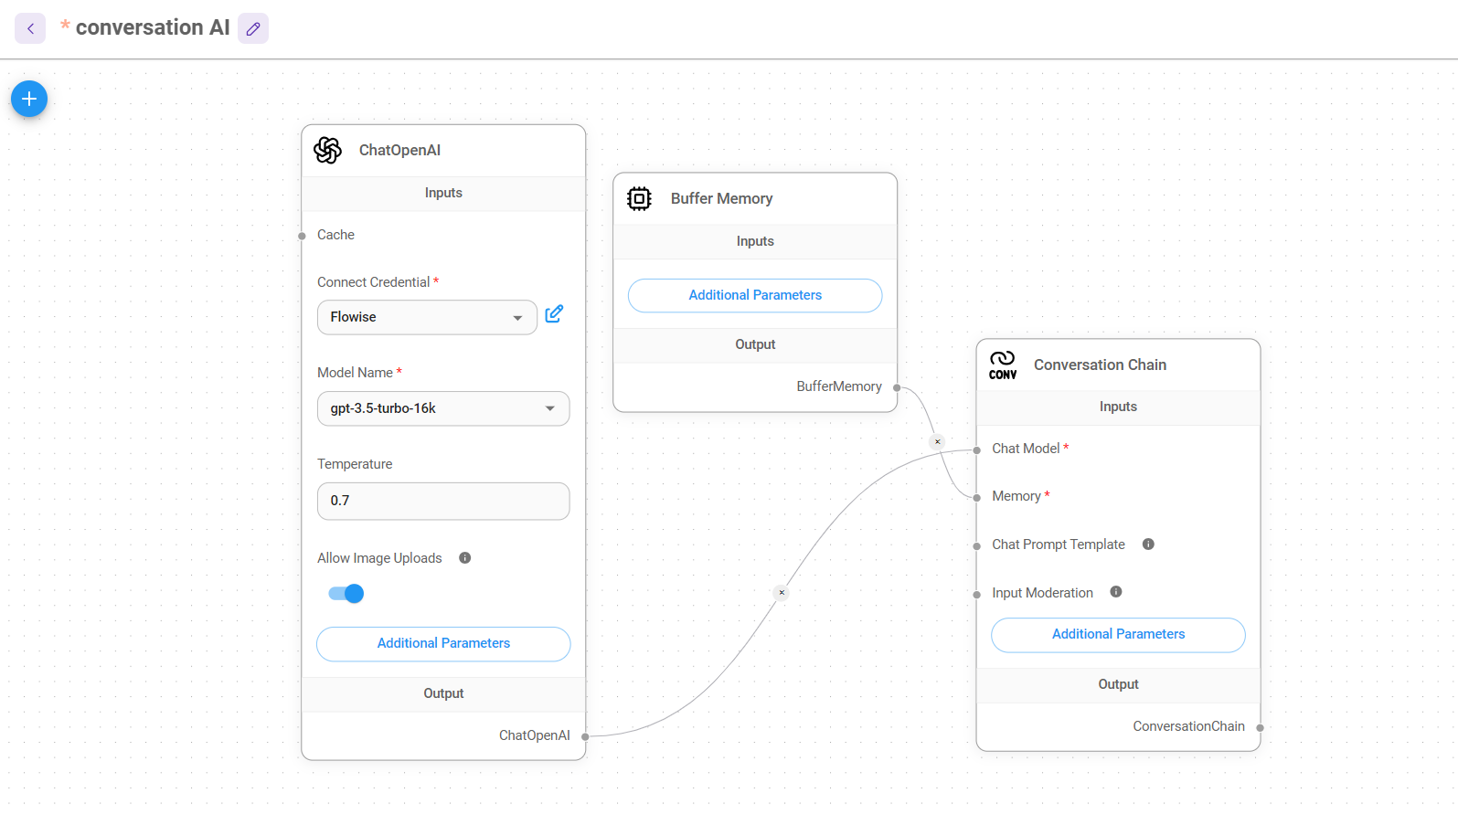
Flowise

Slide 15
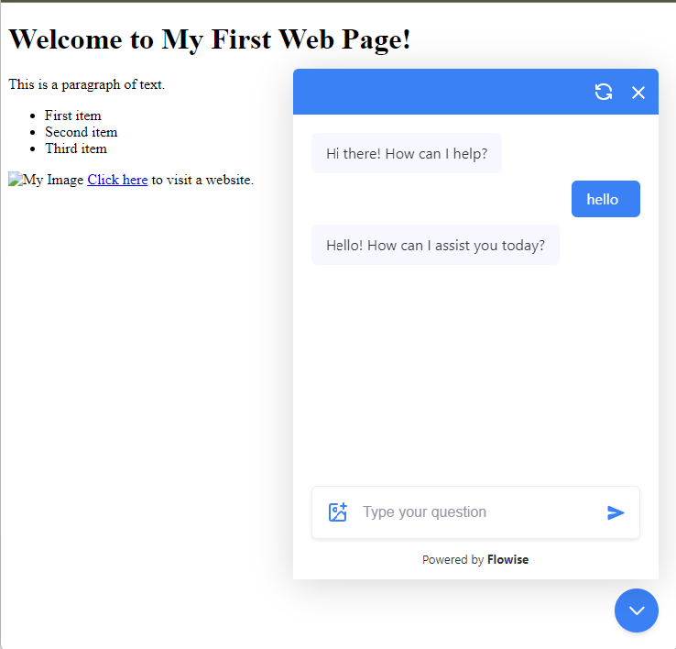
Integrate in webpage
https://github.com/Birmingham-AI/research-compass Inspired from - https://github.com/assafelovic/gpt-researcher

Slide 16

Interested in facilitating our next event?! 🔥
We’re looking for volunteers!

Slide 17
See you at the next event…
Thanks for coming!

